Slide 1
Overall Report of Pi Logger system
Hiroshi OKAMOTO.
From 2018-11-08 to 2018-11-18

Slide 2
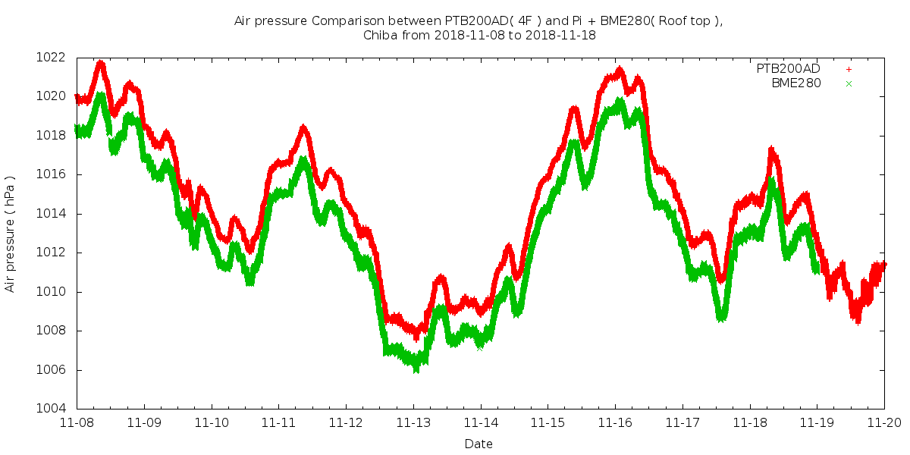
Air Pressure.

Slide 3
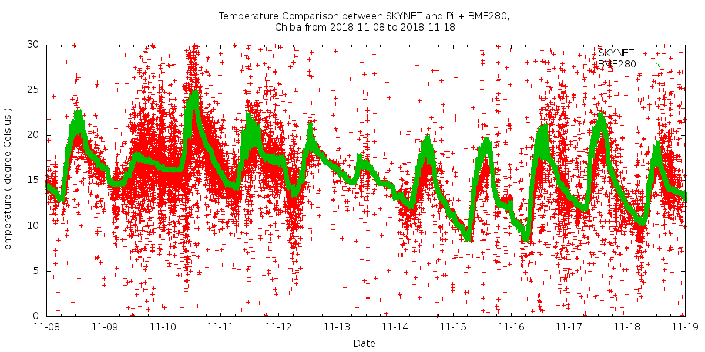
Temperature.

Slide 4
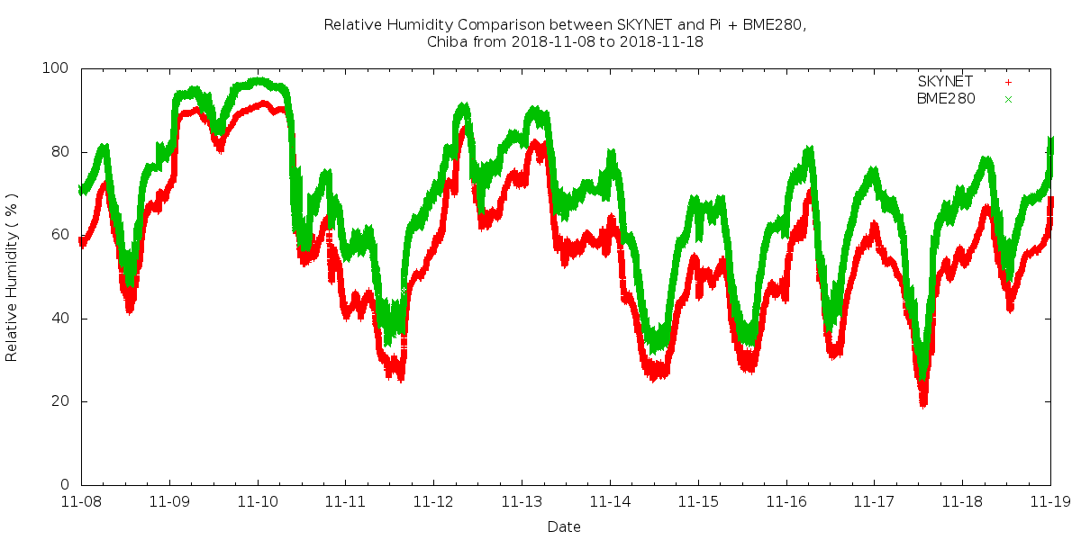
Relative Humidity.

